Slide 1







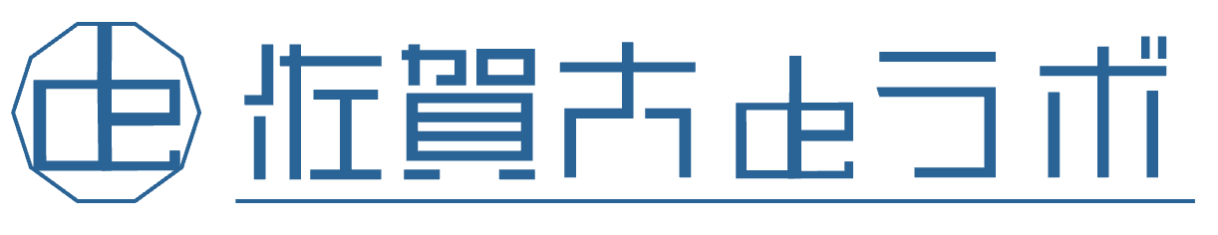


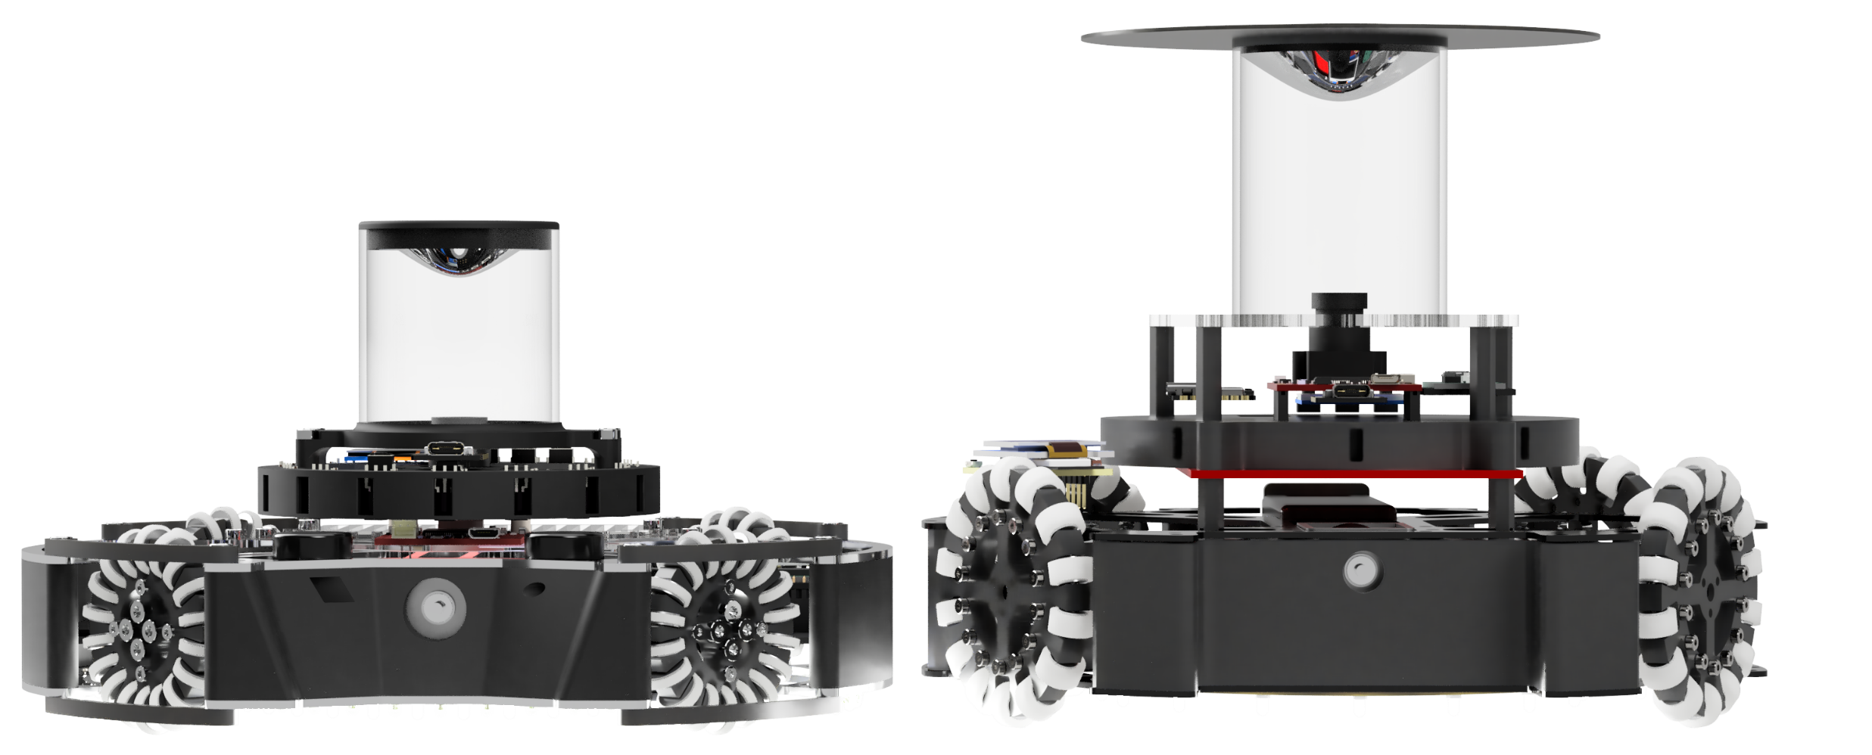
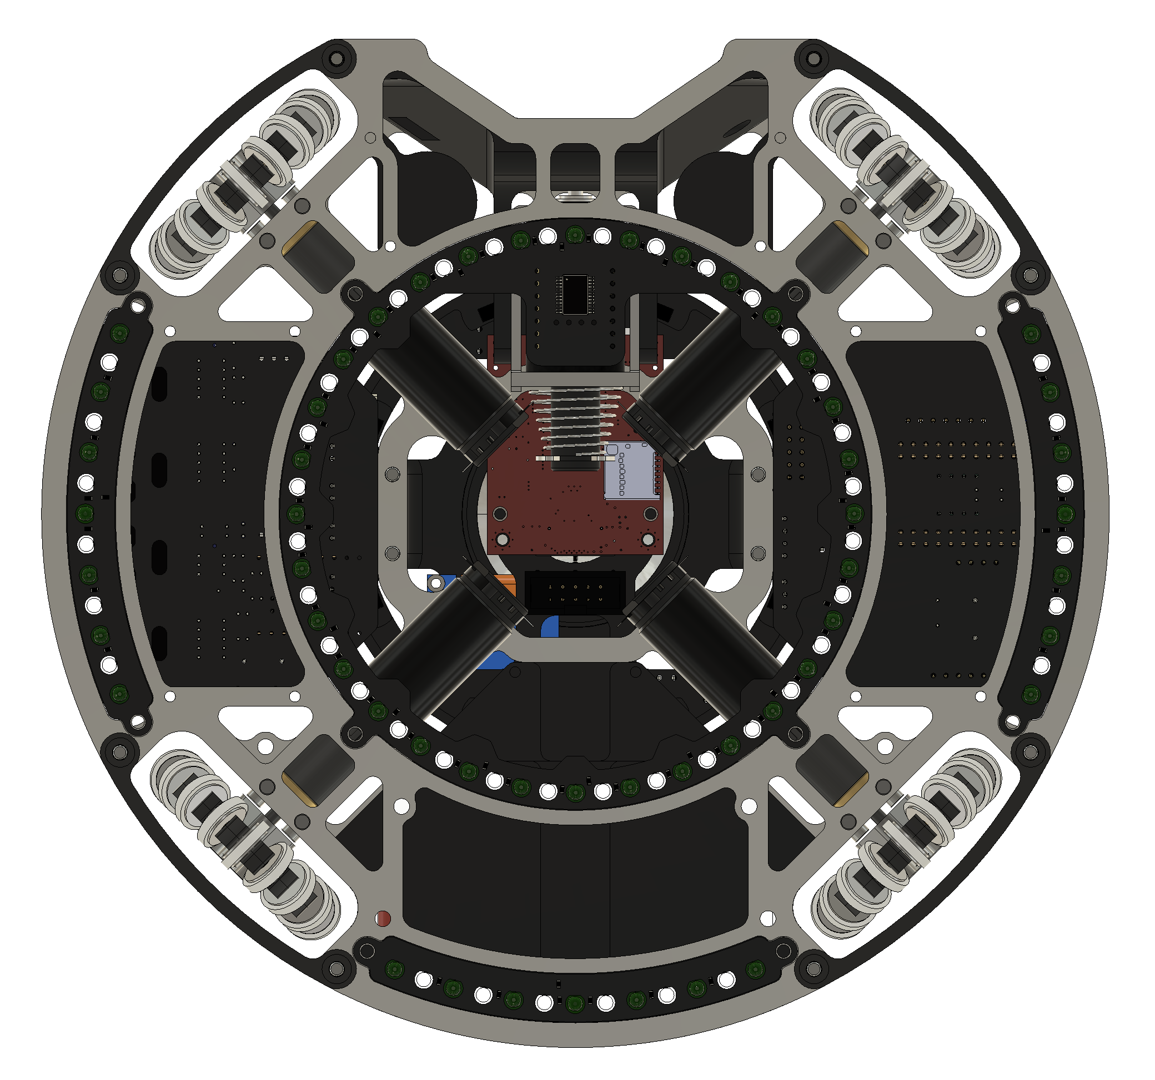
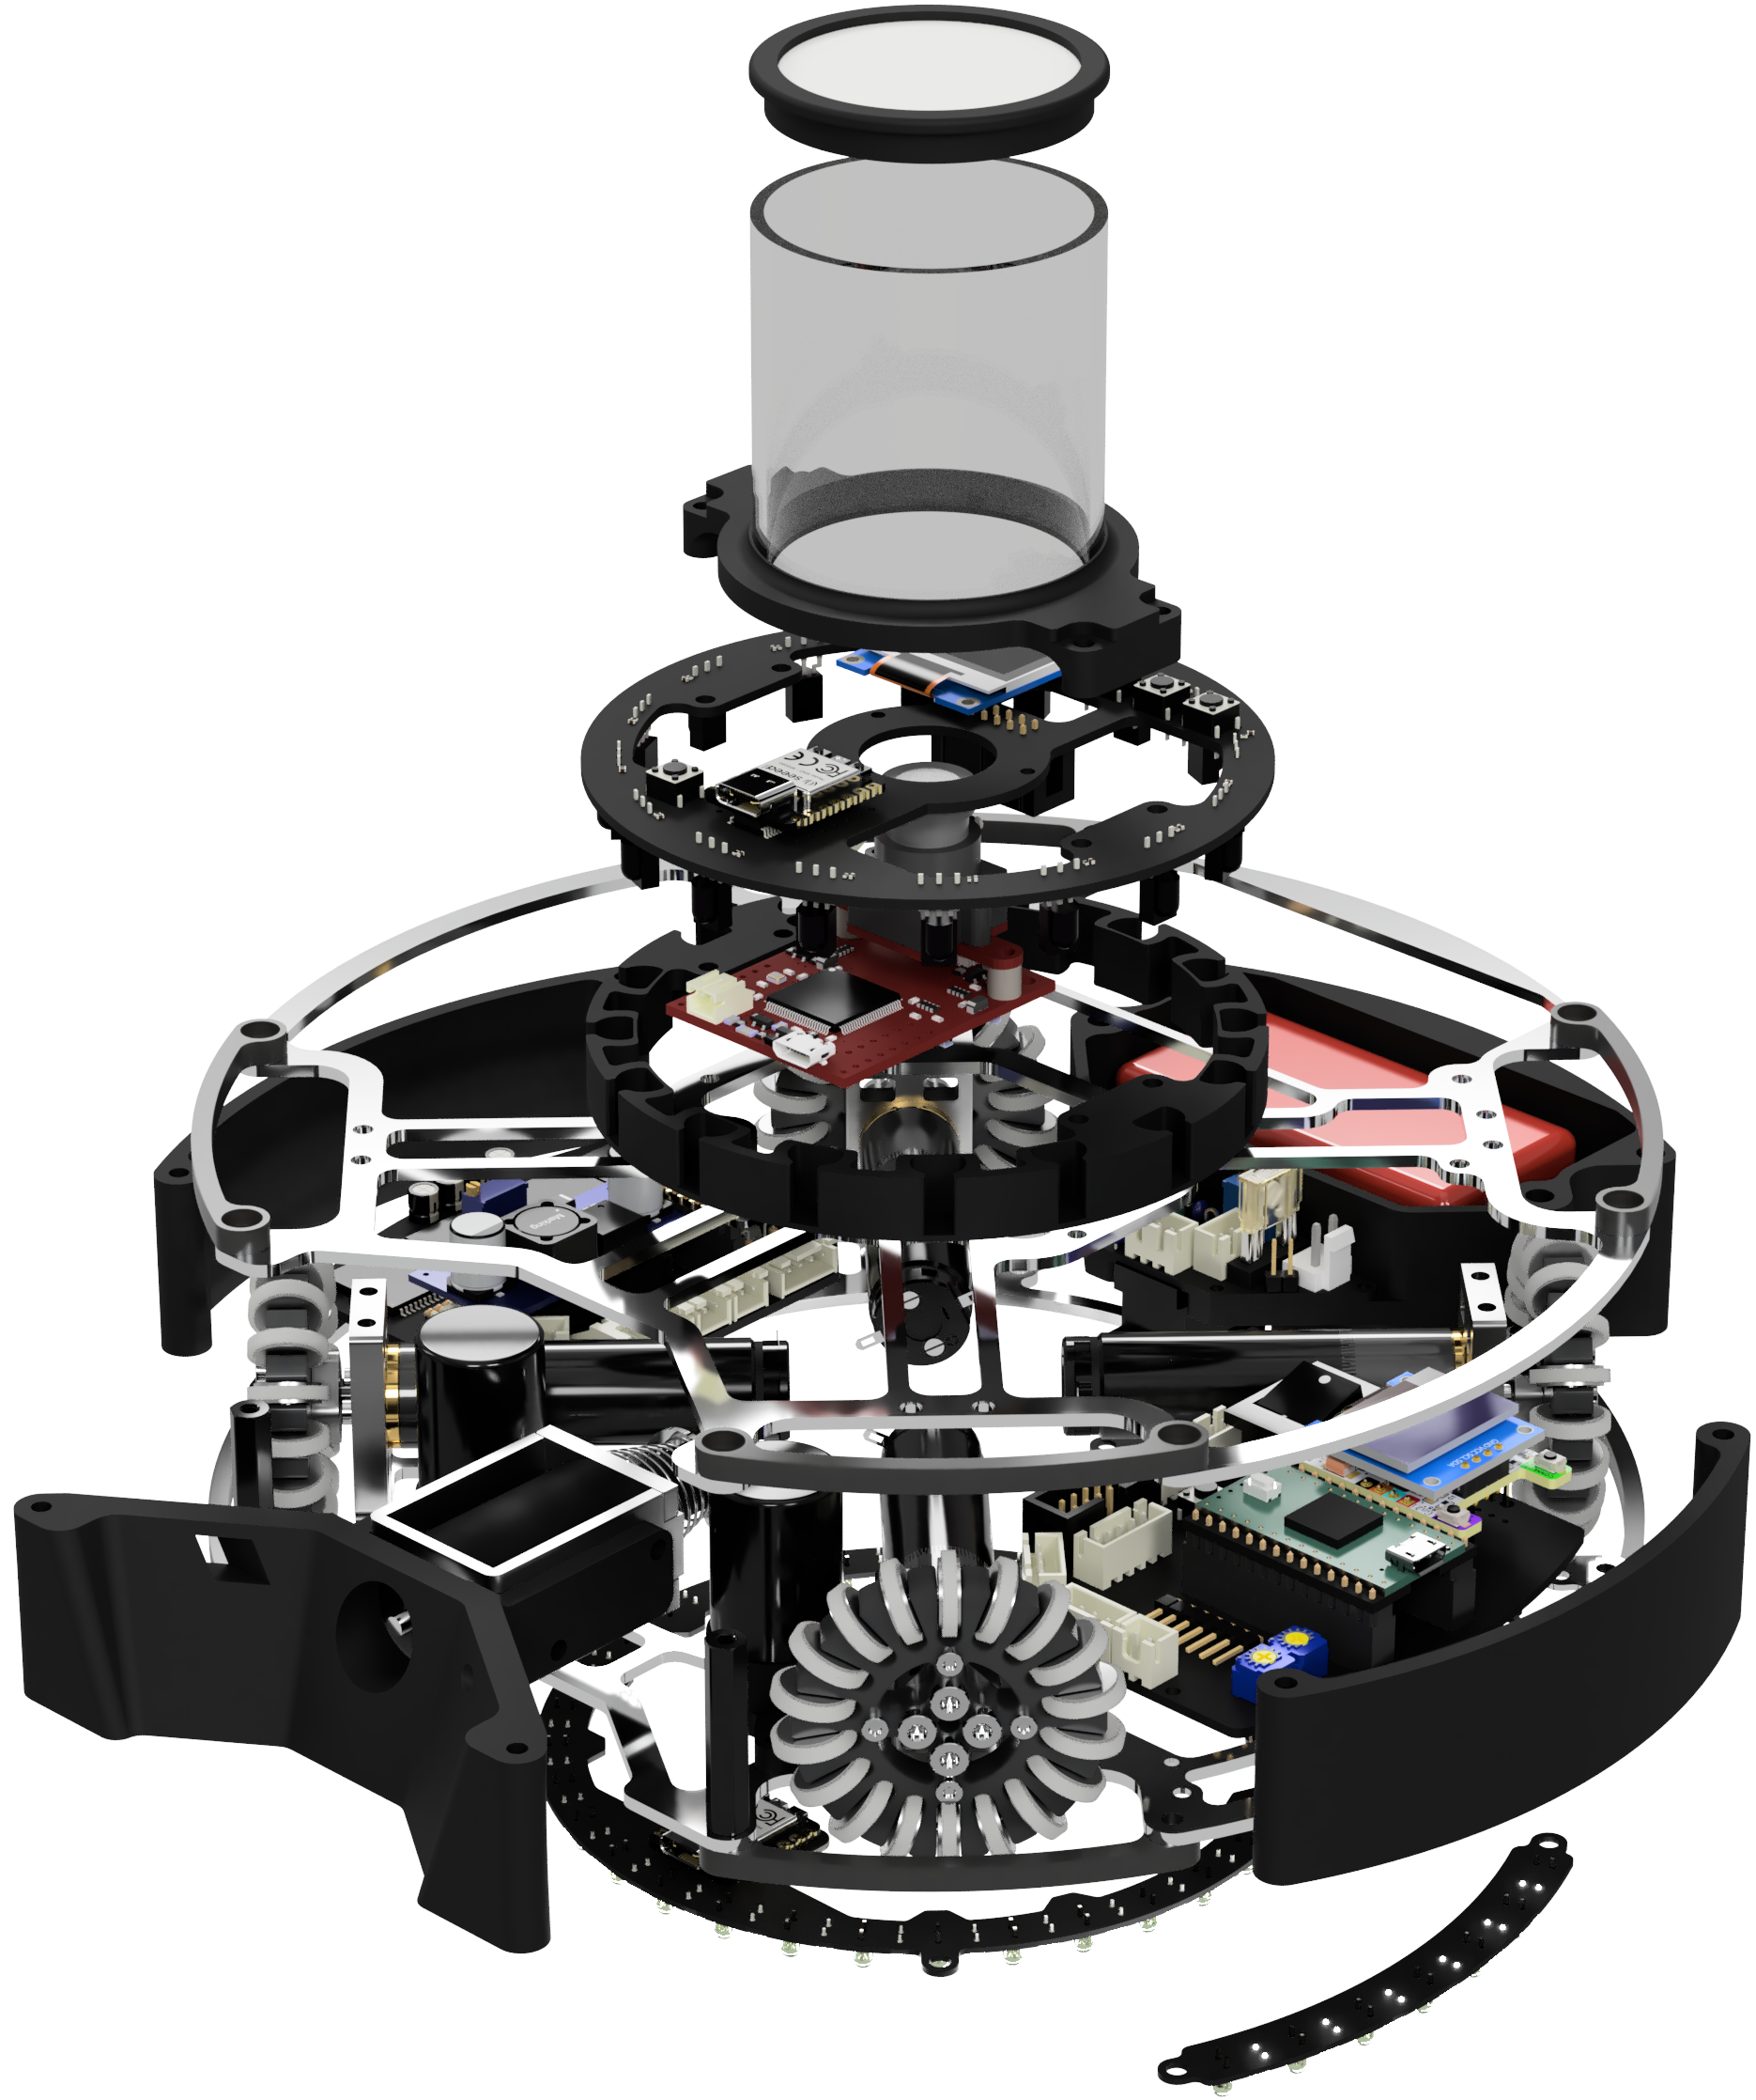
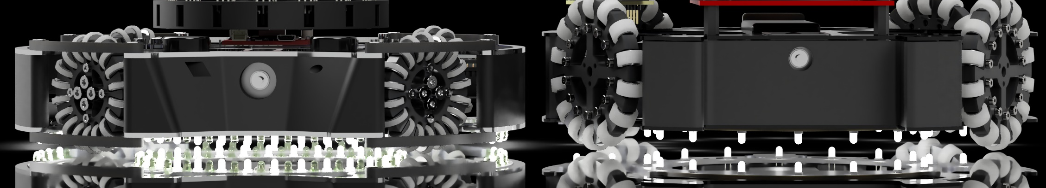
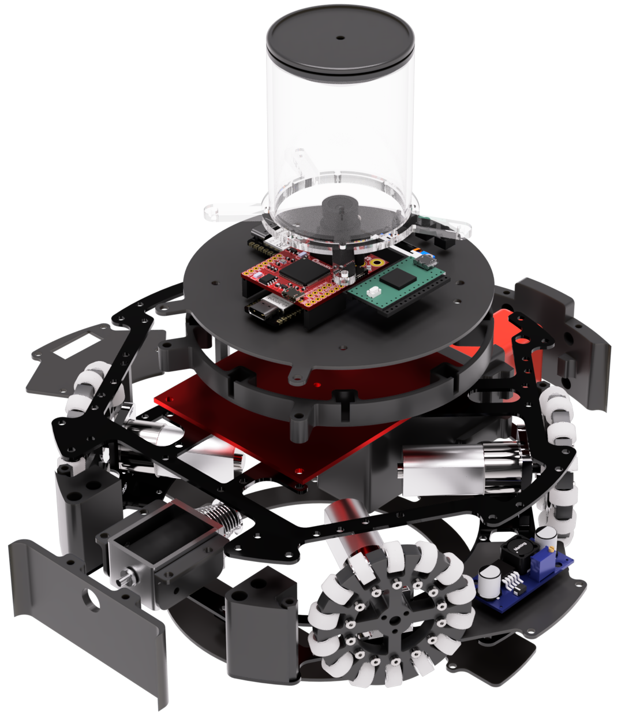
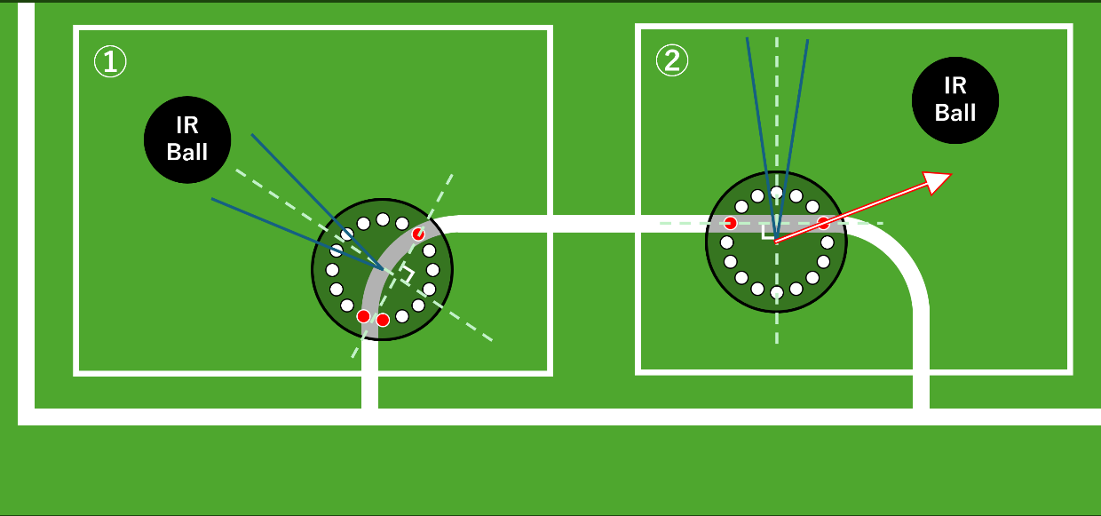
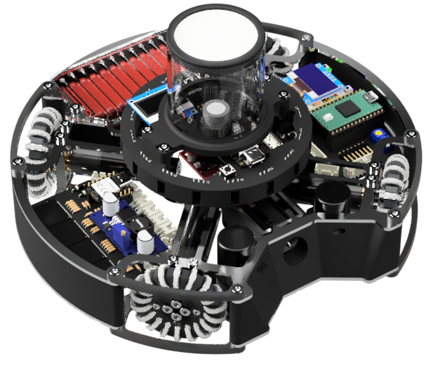
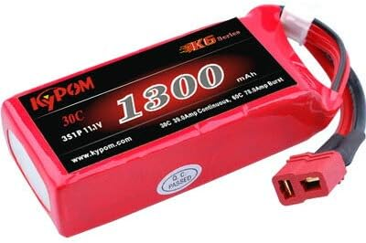
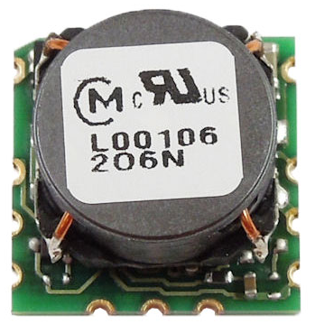
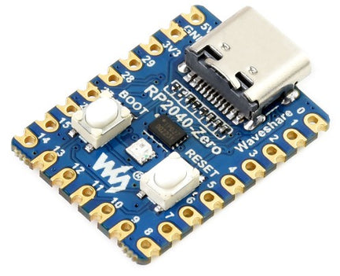
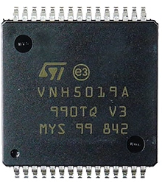
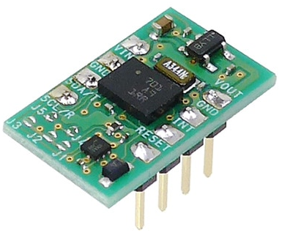
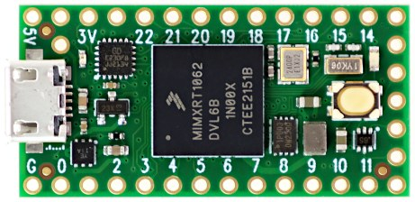
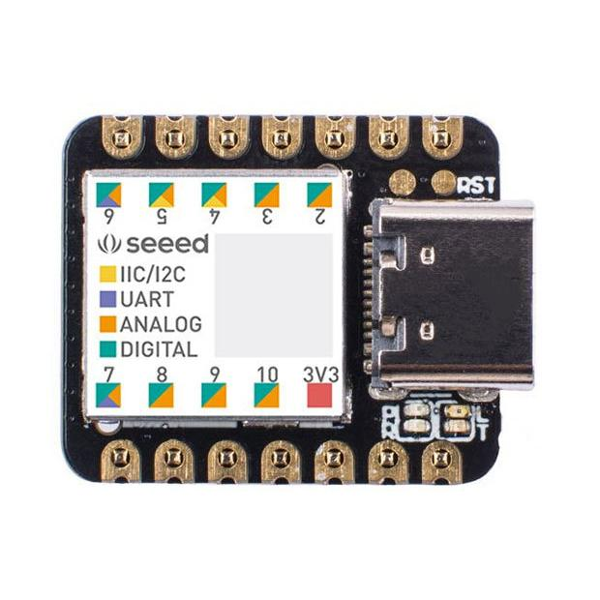
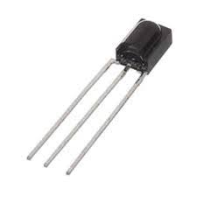

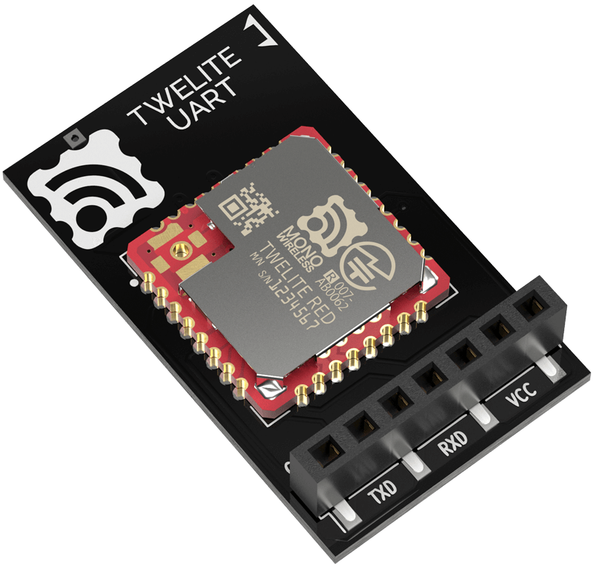
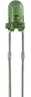
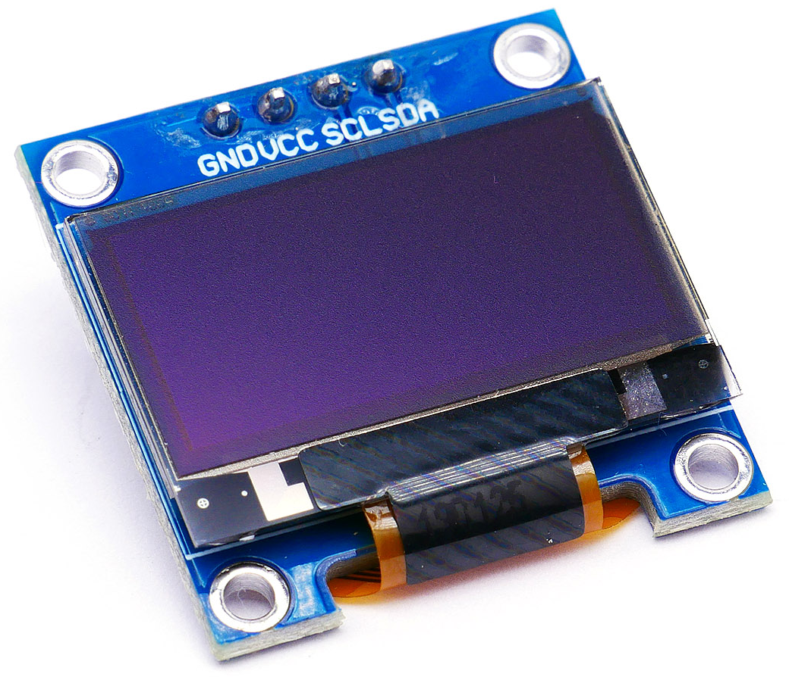



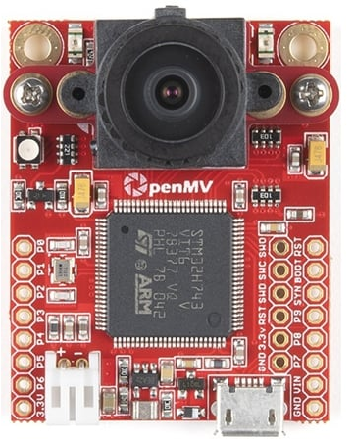
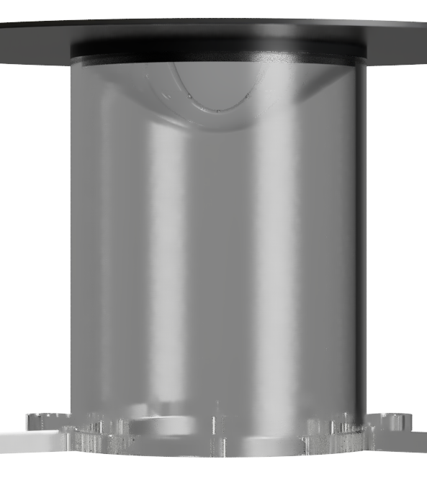
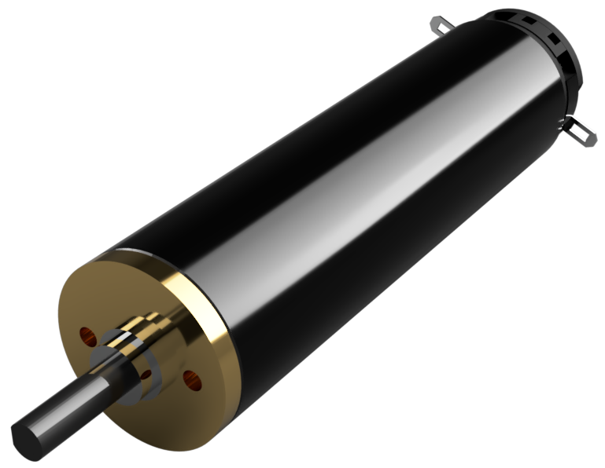
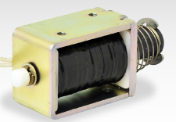
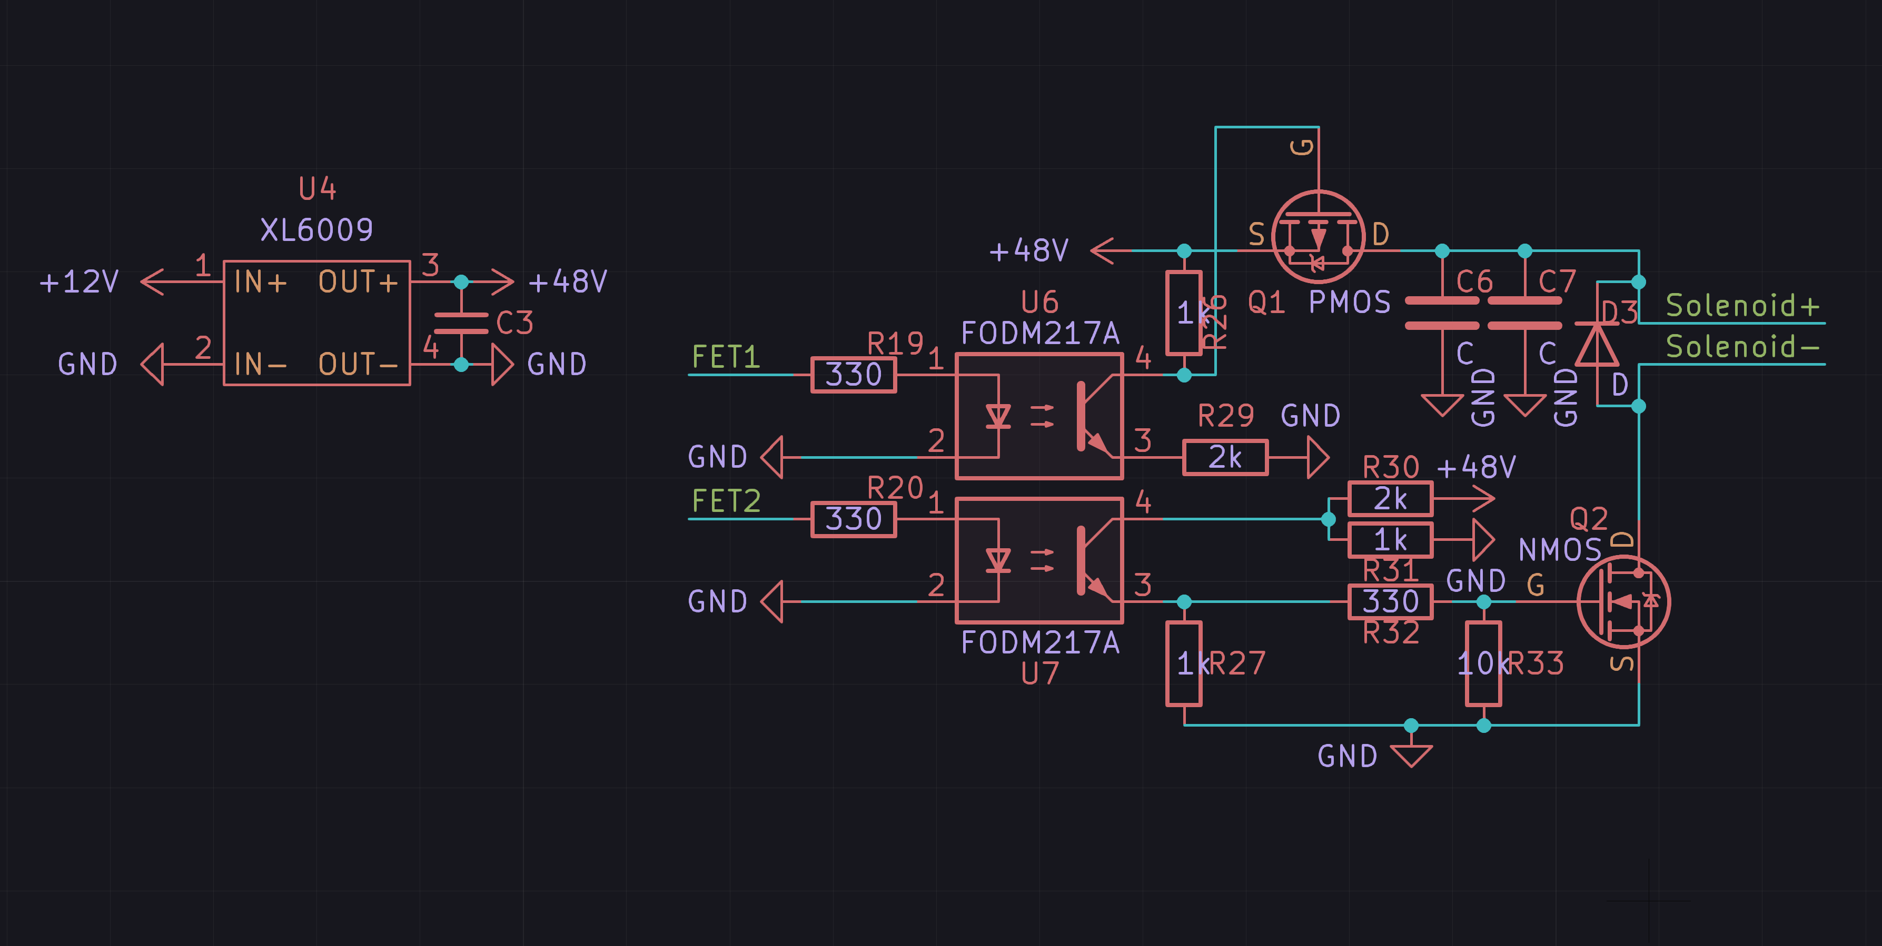



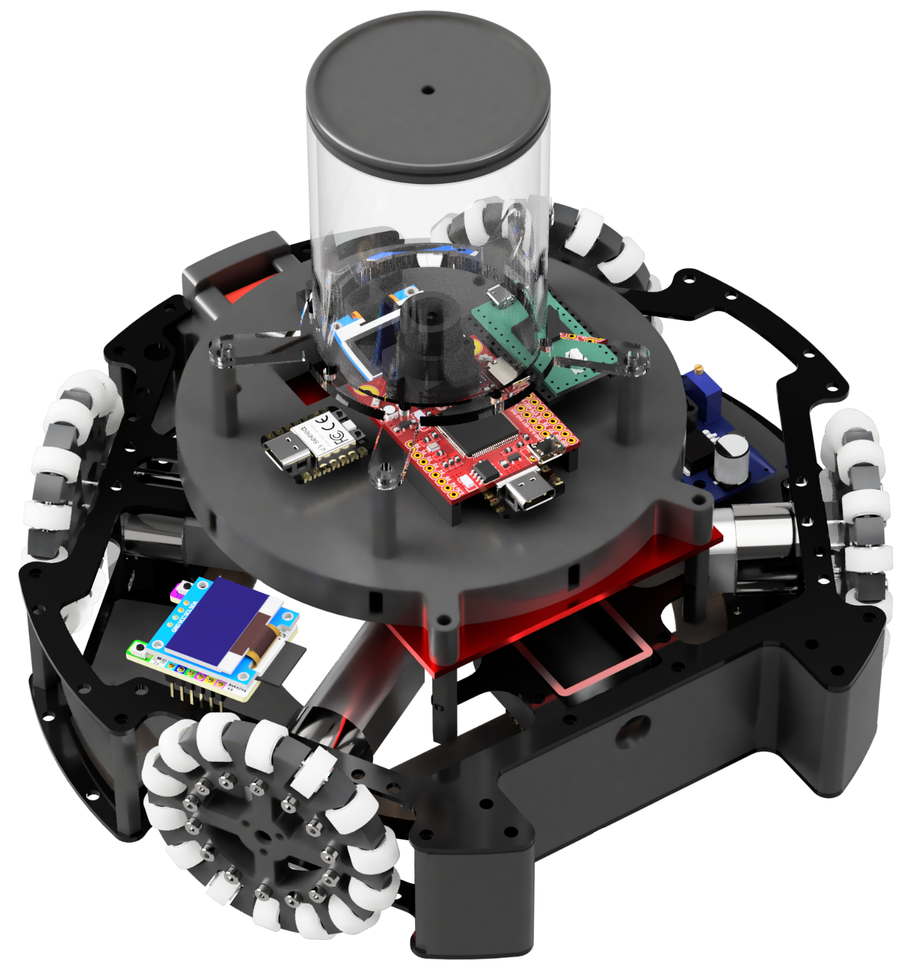
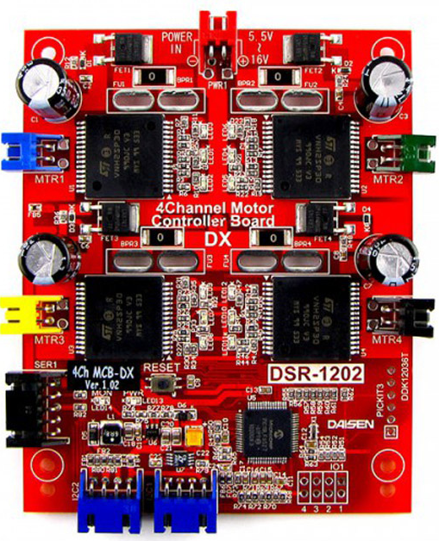

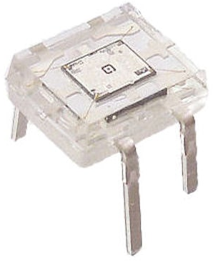
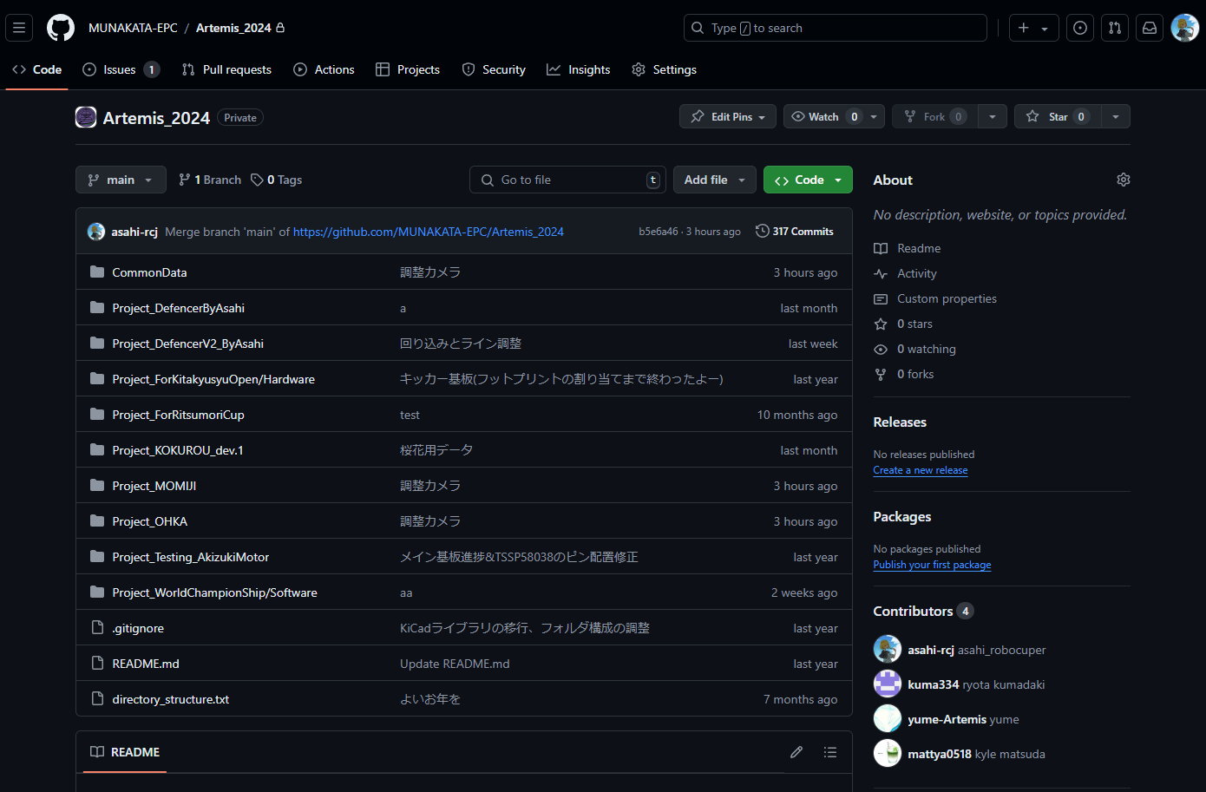
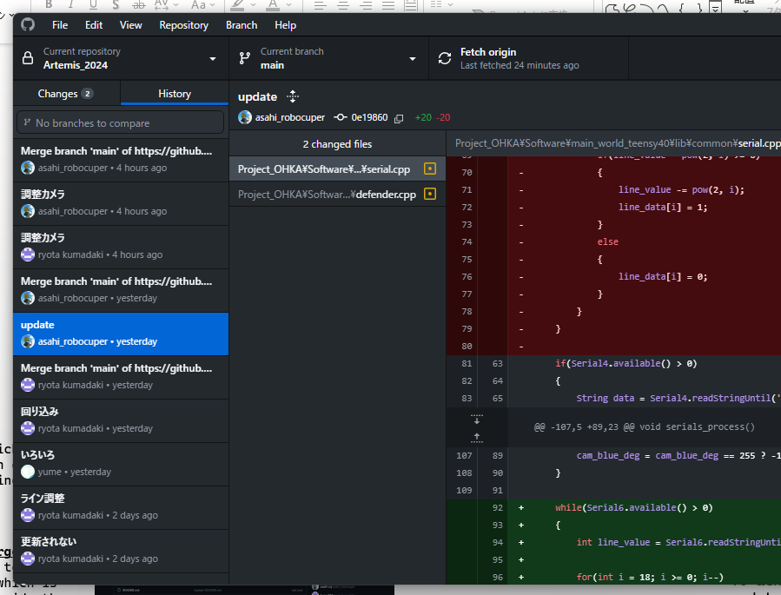
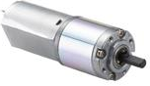
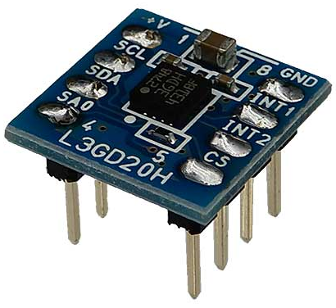
Munako Artemis Munakata High School
REGION
LEAGUE
Team Member
Team Website
https://munako-artemis.github.io/
Team X(Twitter)
https://x.com/munako_artemis Team GitHub
https://github.com/MUNAKATA-EPC
JAPAN
Soccer LWL
Kyle Matsuda : Hardware Yuki Meno : Hardware
Rentaro Ishihara : Software Ryota Kumadaki : Software
SPONSERS
Website
X(Twitter)
GitHub
Method / Production / Design
【Robots’ Overview / Descriptions Of The Installed Parts 】
【Robots’ Features】
Robot.1's concept is to be a "robot with a low center of gravity and high maintenance performance". In a robot that moves freely around the court at high speed, having a low center of gravity is crucial. A low center of gravity allows the robot to execute turns and speed changes with minimal force, reducing power consumption and enabling more precise movements.
However, achieving a low center of gravity often means designing the robot to be compact and densely packed with components internally, potentially compromising maintenance accessibility.
To address this challenge, Robot.1 has been designed with a reduced number of components.
Most parts and boards can be quickly removed and replaced, ensuring ease of maintenance despite its low-profile design.
Robot.2's concept is to be a "strong robot with stable operation" for soccer competitions, which is a challenging feat to achieve. However, we have implemented various innovations to achieve this goal.
All components installed in Robot.2 have undergone a year-long development and testing process to ensure stability. Additionally, it is designed to place various additional components for adapting to changes in rules.
By completing the robot production process early and allowing sufficient time for adjustments, we can achieve stable operation and develop a "strong robot".
> Improvement of the shape of the Line Sensor
During the Japan Open 2024, we identified the following issues with our line sensors:
・It was taking too much time for the sensors to detect the white line after the robot has crossed it.
・Poor color compatibility between the sensors and the white line leads to erroneous detections.
To address these issues, we implemented the following improvements.
・Changing the type of the Sensor
As we mentioned earlier, poor color compatibility between the sensors and the white line leaded to erroneous detections, so we have changed the sensor to NJL7502S. By changing the sensor, we can sufficiently detect the difference in response between white and green, enabling us to detect white lines and reduce occurrences of out-of-bounds.
・Changing the shape of the line sensor (Fig.A) We added new sensors to the left, right, and rear in addition to the central circular line sensor. This allows the robot to immediately detect the white line when it crosses over it.
・Increasing the number of the sensor ports For the circular line sensor, reading values from each sensor allows us to estimate the current position of the reacting white line.
Main Board (Robot.1)
This board is equipped with the “Teensy 4.0” main microcontroller, the “BNO055” IMU sensor, the “Twelite UART” communication module for inter-robot communication, the tournament’s official communication module, and various control switches.
All of the data from microcontrollers and sensors on other boards is aggregated here, and this data is used to control the robot.
・Teensy 4.0 : It has many serial ports and very high performance, making it suitable for high-precision control using many sensors and sub-microcontrollers.
・BNO055 : It allows easy control and has less angular drift compared to other IMU sensors.
・Twelite : It enables easy communication by simply connecting it to the microcontroller via UART.
1 Omnidirectional Vision System
We have positioned the camera facing upwards and placed an omnidirectional mirror at the top of an acrylic pipe.
By doing this, we can capture a 360-degree view from the robot without using multiple cameras, significantly simplifying control compared to using multiple cameras.
We are using OpenMV as camera module. It is programmed with MicroPython.
A
1
Robo.1
1
B
2
Debugging Components
We have placed menu operation buttons and a small LCD monitor at the rear of the robot.
These are positioned for easy access during a match, allowing us to check sensor values and change the robot’s
Mode without connecting to a computer.
2
7
4
Fig.A a shape of line sensor (Robot.1)
6
7
Abstract
Ball Capture Detecting Sensor
We have placed an LED on one side of the ball supplement area, and an S4282-51 photodetector IC on the other side, which detects the ball supplement.
This IC responds only to light of a frequency synchronized with the IC itself, allowing it to be used even in daylight or under an indoor lighting without causing false detections, making it ideal for precise control.
8
3
B. Drive Board (Robot.1)
This board incorporates a motor driver circuit and a kicker drive circuit.
We have chosen VNH5019 for the motor driver IC, and XL6009 for the voltage booster included to de kicker circuit.
The motor driver IC can handle a power supply voltage of up to 41V, which is more than three times the voltage supplied from the battery, and it supports an extremely high current of 30A, ensuring high durability.
The kicker circuit uses two types of MOSFETs, P-channel and N-channel. One is used for controlling the solenoid, and the other is used to disconnect the circuit during the kick motion.
By isolating the kicker circuit from other circuits during kicking, we can physically block the electrical noise caused by the voltage drop during the kicking motion and the back electromotive force generated when the solenoid's shaft returns.
This ensures that no noise affects both the driving power supply and the control power supply.
Munako Artemis is a Japanese team participating in Soccer LWL. The team consists of four high school students and has been active since 2021.
For robot design, we mainly use Autodesk Fusion, and for circuit design, we use KiCad. By utilizing 3D printers and CNC milling machines, we efficiently created our robots. Almost all the sensors and microcontrollers are the same among both of our robots, simplifying parts management and increasing compatibility. Additionally, the programming is primarily done in C++ for most microcontrollers and in MicroPython for the camera.
In preparation for the world tournament, we made modifications to our robots to address various issues identified in the Japan Open 2024. One significant problem was the frequent occurrence of out-of-bounds, so we improved the shape of the line sensors from a linear to a circular design and changed the sensor processing algorithm. Additionally, we often had difficulty carrying the ball forward, so we expanded the ball-capturing zone to make it easier to capture the ball and improved the ball-tracking algorithm.
Both of our robots are equipped with a kicker mechanism that uses a solenoid to kick the ball. However, we had no idea which voltage and capacitor capacity would result in the strongest kick. Therefore, we investigated how the kicking power changes with different voltages and capacitor capacities and created graphs to determine the optimal settings for the strongest kick.
Although this is our first time participating in a world tournament, we are strongly motivated by the desire to "interact with various people, acquire diverse knowledge, and gain valuable experiences." To share our knowledge with a wider audience, we have created a website and social media accounts.
A
B
> Improvement of Ball Access Time
through Ball Tracking Algorithm Enhancement
During the national competition, we identified the following issues with our ball tracking algorithm: Lack of distance-based control between the robot and the ball resulted in excessive rounding, leading to delayed ball access.
To address these issues, we developed the following ball tracking algorithm:
In the diagram on the right, we define Ball Angle as the angle of the ball relative to the robot, and Move Direction as the actual angle of movement of the robot.
When the robot is close to the ball (Fig.B-1)
Move in the tangential direction to the ball (= Ball Angle + 90) to approach the ball.
B. When the robot is far from the ball (Fig.B-2)
Add a constant (= Ball Angle + X) to move towards the ball.
By doing these, the robot can approach to it shorter way than before, and colliding with the ball is almost nothing, so own-goal was decreasing.
Ball Angle
3
Move
Direction
IR Sensor
We have chosen the TSSP58038 for the ball detection. By placing 16 of them in a circular pattern on the central board, we can calculate the angle of the ball more accurately.
4
90°
90°
Line Sensor
We have positioned a circular board in the center and a board with a circular cut-out shape on the outer edge. The description about the line sensor is summarized in
“Robot’s Feature” section.
90°
5
9
5
Fig.B-1 ball-tracking system when ball is near
Power Circuit Board
The power circuit board includes battery protection circuits, and circuits for generating both the drive power supply and control power supply.
The battery protection circuits feature reverse connection protection, overcurrent protection, and over-discharge prevention.
To generate the control power supply, a DC-DC converter is used, which minimizes the electrical noise from the drive power supply, ensuring stable operation of the microcontrollers.
Robo.2
X°
6
1
C. Main Board (Robot.2)
This board is equipped with a Teensy 4.0 as the main microcontroller, an L3GD20H and a BNO055 as IMU sensors, an OpenMV camera, an SSD1306 display, and TSSP58038 sensors for ball detection.
There are eight IR sensors installed to calculate the ball's angle using vector processing.
Two gyro sensors are installed to ensure redundancy in case one fails during the match.
Additionally, the display allows us to check the sensor values and to change the robot's mode without connecting it to a computer, making adjustments to the robot more easily.
4
C
6
2
C
Fig.B-2 ball-tracking system when ball is far
7 Motor
Robot.1 : We use Maxon's RE16 series motors, which offer high efficiency and responsiveness, reducing the robot's power consumption and enabling finer movements.
Robot.2 : We have adopted the DIGILENT IG22 1/19 motor.
Despite being lightweight, it offers high responsiveness and speed.
> Line Tracing Defense Using Circular Line Sensors
Our robot is equipped with circular line sensors, which we utilize for goal defense through line tracing. The defense system is illustrated in Fig.C.
It uses the perpendicular line to the line connecting the two line sensors reacting to the white line as the reference line.
In case ①, when the angle of the ball and the reference line have a small error, the robot stops to block the shot from an oblique direction.
In case ②, when the angle of the ball and the reference line have a large error, the robot moves in the direction of the line sensor detecting the ball, keeping it on the white line while moving towards the ball to block the shot. By combining these movements in cases ① and ②, the robot can effectively prevent the ball from entering the goal.
7
D
3
D. Motor Driver : DSR-1202 (Robot.2)
We have adopted the DSR-1202 from the Japanese manufacturer DAISEN. It supports high current and can be easily used by connecting to the microcontroller via UART.
Our Robots’ Structure
D
Solenoid
We have selected Takaha's CB1037 solenoid for the kicker.
Among solenoids of similar size in the series, it has a longer stroke and delivers greater kicking force relative to its size, making it ideal for a compact and high-power kicker unit.
7
8
E. Kicker Board (Robot.2)
We use the XL6009 voltage boost IC to step up the voltage to approximately 47V.
For noise reduction, during kicking, we utilize a P channel MOSFET to isolate the kicker circuit from all other circuits, effectively suppressing noise.
The circuit is equipped with two 50V 4700μF charging capacitors.
( For details, check the [ Data / Results / Discussion ] section )
Robo.1
E
Battery
Kypom 3S 11.1V
1300mAh
11.1V
Drive Circuit Board : Kicker System And Motor Driver
E
11.1V
Voltage Conversion Circuit
Using IC :
OKL-T/6-W12N-C
11.1V to 5.0V
Kicker System
(Please look at
“Kicker System And Research About Voltage & Capacity Of Capacitors”)
Sub Controller
RP2040 ZERO
Motor Driver
ｘ4
IC : VNH5019A-E
9 Frame : A2017
The frame was designed using Autodesk Fusion and machined using a CNC. A2017 Duralumin, known for its excellent durability, allows for a lightweight yet extremely sturdy frame.
9
8
9
5
Fig.C Goal Defense System
Gyro Sensor
BNO055
5.0V
Sub Controller
Seeeduino Xiao
IR Sensors
TSSP58038 x 16
I²C
Main Controller
Teensy 4.0
ANALOG
Data / Results / Discussion
Team Activities
UART
UART
Wireless
Communication
Twelite UART
UART
Sub Controller
Seeeduino Xiao
ANALOG
Line Sensors
NJL7502L x 53
About 48V
【About the kicking mechanism and the research about
the voltage and the capacitance of capacitors】
Our robots are equipped with a solenoid which is used for a ball kicking mechanism.
It can kick the ball when you apply high voltage to the solenoid and uses a big capacitance charging capacitor.
The circuit of the kicker mechanism is shown below Fig.1.
However, we had no idea how high the voltage and how big the capacitance of the capacitor should be when we use the solenoid as the kicking system.
Therefore, we decided to research how the kick power will change when we changed the voltage and capacitor capacitance.
<Details Of Research>
Measure the difference of the kicking power when you changed the voltage applied to the solenoid and the capacitance of the capacitor to find the optimal conditions for equipping the solenoid on the robot.
This time we used capacitors from NIPPON CHEMI-CON, Nichicon, Rubycon.
<Research Procedure>
Step 1. make a solenoid drive board which can change the charging capacitor and the
voltage which will be applied to the capacitor.
Step 2. Measure the kick power (*1) by keeping the voltage constant and varying the capacitance of the capacitor.
Step 3. Measure the kick power (*1) by varying the voltage without changing the capacitance.
Step 4. Create a graph based on the experimental data obtained from Step 2 and 3.
(*1) Place a long ruler on the court and kick the ball on it and the kicking power is defined as the distance the ball stopped.
<Results>
In Fig.2, you can see that the voltage variation and the change in kicking power follow a linear relationship. Similarly, in Fig.3, the change in capacitor capacity and the variation in kicking power also appear to follow a linear relationship.
<Discussion>
Based on these findings, it is considered that higher voltage and larger capacitor capacity lead to greater kicking power. Therefore, we aimed to get as close as possible to the maximum voltage limit allowed by the rules, which is 48V, and selected capacitor capacities based on the available space inside the robot. Robo.1 was equipped with a 6600μF capacitor, and Robo.2 with two 4700μF capacitor, to maximize kicking power as much as possible.
【Enhancing Team Collaboration with Various Tools】
In our team, we make our collaboration in diverse aspects such as robot design and programming more efficient by using a variety of tools.
All the tools we use are shown below:
・Robot Design : Autodesk Fusion
・Circuit Design : KiCad 6.0 / 7.0
・Programming Tool : Visual Studio Code
(With PlatformIO)
・Source Management : GitHub
(GitHub Desktop)
As a data management tool within our team, we use GitHub (Fig.4).
GitHub is an online source code hosting service where we primarily store files and source code related to robot production. Since these are hosted on the internet, everyone can always access the latest data regardless of location or team member, ensuring that the most current progress is always shared and team development proceeds smoothly.
Additionally, we use GitHub Desktop (Fig.5), a GUI tool, to make using GitHub easier and more understandable compared to the command-line-based Git. We have been using GitHub since 2023. We have published our 2023 season's hardware and software, so please take a look.
Link : https://github.com/MUNAKATA-EPC/Artemis_2023
【Enhancing Team Efficiency through Multiple Workflows】
In team development, the robot production and the software development is difficult to progress at the same time, and this often leads to a single workflow (Fig.6). Given the extremely short preparation period for the world championship, our team found that operating under a single workflow was highly inefficient. Therefore, we proceeded with multiple workflows (Fig.7), which not only allowed us to start working on tasks earlier but also created significant time flexibility.
I²C
Digital x 3
11.1V
(mm)
UART
Debug System
Motor
Maxon RE16
Vision System
O-LED
Display
SSD1306 x 1
Solenoid
CB1037 x 1
FET1 and FET2 are controlled by signals from the microcontroller.
When FET1 is set to HIGH, the connected capacitors (C6, C7) will be charged up. When FET2 is set to HIGH, the solenoid operates using the power stored in the charged capacitors.
Setting FET1 to LOW isolates the kicker circuit from all other circuits using P channel MOSFET, effectively blocking electrical noise.
Autodesk
Fusion
Tactile Switch x 3
( For switching
robot’s mode)
KiCad
GitHub
Robot Design
Circuit Design
Hardware Tasks
OpenMV H7 x 1
Omnidirectional Mirror
X 4
(μF)
Visual Studio Code
Discord
Google
Spreadsheet
Making
Parts
Assembly
Robot
Robot Maintenance
Robo.2
Check
Sensors
Software Tasks
Battery
Kypom 3S 11.1V
1300mAh
11.1V
Voltage
Conversion Circuit
Using IC :
OKL-T/6-W12N-C
11.1V to 5.0V
11.1V
Kicker System
(Please look at
“Kicker System And Research About Voltage & Capacity Of Capacitors”)
About
48V
Solenoid
CB1037 x 1
Problems:
・Software programmer can’t develop robot’s program until Hardware Engineer finished making them.
・Hardware engineer can’t improve the robots’ problem that is found after finishing making them.
Develop
Software Programs
11.1V
5.0V
Sub Controller
Seeeduino Xiao
IR Sensors
TSSP58038 x 16
Fig.1. The circuit of the kicker mechanism
Fig.6 Specific System and Problems of Single Workflow
Motor Driver
DAISEN DSR-1202
Main Controller
Teensy 4.0
UART
ANALOG
Robot Design
Circuit Design
Hardware Tasks
IC:VNH2SP30 x 4
・0.3V ~ 16.0V
・15~30A / channel
UART
Sub Controller
Seeeduino Xiao
Line Sensors
S4282-51 x 22
Advantages:
・Software programmer
can give feedback about
robots while hardware
engineer is developing.
・We can do software and hardware development at the same time.
Making
Parts
11.1V
Wireless
Communication
Twelite UART
UART
UART
UART
DIGITAL
Feedback
Assembly
Robot
Robot Maintenance
Sub Controller
Seeeduino Xiao
I²C + Digital x 3
Checking the operation of robots’ parts
Software Tasks
Vision System
Debug System
Develop Software Programs
Motor
DIGILENT IG22 1/19
Gyro Sensors
L3GD20H
&
BNO055
O-LED
Display
SSD1306 x 1
Fig.7 Specific System and Advantages of Multiple Workflow
X 4
I²C
OpenMV H7 x 1
Omnidirectional Mirror
Tactile Switch x 3
( For switching
robot’s mode)
To achieve multiple workflows, as we mentioned earlier, we actively used task management tools and communication tools. This allowed the entire team to work on multiple tasks at the same time, thereby enhancing the efficiency of team activities.
Fig.4 GitHub(Munako Artemis Season 2024)
Fig.5 GitHub Desktop

